Slide 1
NEBRASKA PRESS ADVERTISING SERVICE
BOOT CAMP
JULY 20, 2011

Slide 2
Effective Selling Means:
Getting to know your product inside and out!
Getting to know yourself.
Learning about your customer’s business. Understanding his/her wants and needs.
Coming to a conclusion about how your newspaper can best be utilized, and then developing a long-term plan.
Bringing your customer to the same conclusion.
Implementing the plan!!!

Slide 3
ADVERTISING: What is it?
Advertising is the business, or the art, if you please, of telling someone something that should be important to him or her. It is a substitute for talking to someone.
-by Fairfax M. Cone
Foote, Cone & Belding

Slide 4
Newspaper Readers are Most Wanted Consumers
Newspapers are widely accepted in Nebraska. 91% of adults in Nebraska read a newspaper in the past four weeks
There are 2.5 readers per copy
As household income rises, so does newspaper readership
Educated consumers are newspapers’ best customers
Newspaper readership increases with more job responsibility
Newspaper readership increases with home value

Slide 5
Newspapers are Nebraskan’s
#1 source for news
Local news about your community: 52.8%
County news: 66.7%
Nebraska news: 46%
US national news: 22%
World news: 20%
Entertainment: 54%
Where to shop: 67%
Cost of products: 64%

Slide 6
Newspapers are a user friendly medium
Reading a newspaper involves dedicated mental and physical interaction.
This involvement results in a captive audience that is focused on the information at hand.
Information of value can be absorbed, scrutinized, clipped, copied and saved for future reference at the convenience of the reader.

Slide 7
Online Advertising Glossary
CPM/Cost Per 1000 Impressions –
Advertiser pays every time 1000 impressions of their ad are shown (can’t guarantee they are seen by the user).
CTR/Click Thru Ratio –
The percent of impressions of an ad that are clicked on. CTR = #Clicks / #Impressions.
Impression –
A single potential view of an ad. This is not the same as actual views, because an ad may be out of view or not seen by a reader or web user.
Tracking –
The ability of online advertising to measure every step of the advertising process, from impression, to click-to action, to advertiser revenue. Tracking is done with server logs, ad management software, and other software packages.
Unique User –
A view of your web site by a unique person. Multiple visits in that time period, by the same person, count as a single unique user. You can get this number from your server logs.

Slide 8
Assessing Your Strengths and Weaknesses
Attitude
Product knowledge
People skills
Persuasive ability
Telephone skills
Creative ability
Organizational skills
Writing skills
Prospecting skills
Management skills
Reliability/service skills
Ability to focus/set goals
Dealing with rejection/objections
Selling new business
Level of commitment
Presentation skills
Questioning and listening skills
Self-confidence

Slide 9
“Attitude” Is Key
Eighty-five percent of what you attain in life is based on attitude. In a recent survey, ninety-four percent of top executives say their attitude got them where they are.
Attitudes come from our expectations about outcomes.
Winners have a habit of manufacturing their own positive expectations prior to an event. Positive people affect others in a positive way and good things happen.
Our beliefs are based on our self-concept. We perform in a manner consistent with our basic self-concept. We are what we believe we are. We all want to be “winners,” regardless of how we define being a winner.
Self-esteem is how we feel about ourselves – our self-esteem is always true. How much we like ourselves often determines our success in life.
A poor attitude is generally a result of poor self-esteem.
Bottom Line: Feel good about who you are and what you do!

Slide 10
Goal Setting as a Performance Enhancer:
FACT: Most people don’t have goals
WHY WE DON’T SET GOALS?
1. Don’t know how
2. Fear of rejection
3. Fear of failure
Goals allow us to change the direction of our lives
We must be excellent at something, and we can only be excellent at what we love to do.
Goal categories:
Family and personal
Business and career
Self-improvement

Slide 11
Marketing
…is satisfying the needs and wants of customers at a profit
3 Ps of Marketing
    Price
    Product
    Promotion

Slide 12
10 Keys to Successful Marketing
Have a vision.
Position your business.
Choose the right media to advertise.
Create an effective advertising message.
Establish a budget for your advertising investment.
Determine a mix for your advertising.
Track your advertising investment.
Create effective in-store promotion.
Establish an employee training program.
Demonstrate customer appreciation.

Slide 13
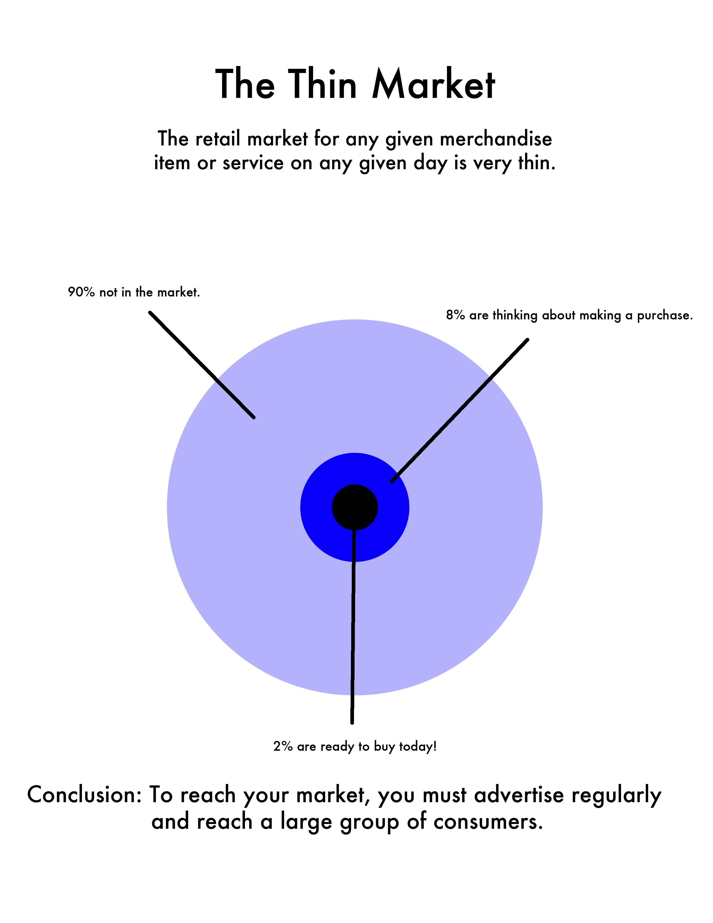

Slide 14
“Push” vs. “Pull” Advertising
“Pull” advertising is geared to draw visitors to your business when they are actively seeking your product or service.
Prime examples of “pull” advertising are search engine optimization, cost per click search engines, directory listings, yellow page ads, newspaper classifieds and shopping portals such as mySimon and DealTime.
“Push” advertising refers to all efforts to get the word out to an entire group of potential customers in order to hit the few that may be currently interested in your product or service.
Most traditional offline advertising efforts (magazine, billboard, newspaper, TV, etc.), as well as online banner ads and email broadcasts, are considered “push” marketing.

Slide 15
Avoid These 11 Advertising Mistakes:
1. Considering advertising as an expense; it is an investment.
2. Expecting instant results. Advertising is like exercise and takes time to build desired results.
3. Waiting until your business is suffering to advertise.
4. Expecting results without planning your advertising.
5. Choosing a medium just because you like the sales person.
6. Forgetting the co-op dollars available to your business.
7. Not budgeting for your advertising.
8. Thinking nothing new is happening in advertising.
9. Not changing with the times.
10. Trying to change too quickly and losing your identity.
11. Not having a uniqueness in your advertising message.

Slide 16
What is Branding?
The American Marketing Association (AMA) defines a brand as a “name, term, sign, symbol or design, or a combination of them intended to identify the goods and services of one seller or group of sellers and to differentiate them from those of other sellers.”

Slide 17
10 Ways to Sabotage a First Impression
1. Treating the receptionist and secretary with less respect than you’d give the prospect. If you plan to build a relationship with that prospect, it’s wise to make a friend of the secretary.
2. Not doing your homework on the company, their needs and problems. Before you make the first contact, be armed with plenty of background information.
3. Arriving at a sales call ill-prepared. Do you have all necessary paper, brochures, samples?
4. Talking too much. Ask questions and listen. Control the conversation, don’t monopolize it.
5. Giving recommendations before asking your prospect’s needs. Even though you’ve researched their needs, ask your prospect what their needs are.
6. Making yourself at home in the prospect’s office before being asked to. Don’t until you’ve been invited to do so.
7. Being late. Just don’t do it. If it’s unavoidable, be sure to call before your scheduled appointment time.
8. Using sloppy or inappropriate language. Be careful of slang and words like, “anyways,” “yeah,” and “you guys.” Don’t curse.
9. Poor grooming. Look professional.
10. Negative attitude. Wear a smile. Be confident. Give your client a solid handshake. A negative attitude will put a cloud over your message.

